Slide 1
AGRICULTURAL BASED
DATA WAREHOUSE
Members: Victor Chin, Disha Patel, Ruthvik Annareddy

Slide 2
PROJECT OVERVIEW
The project aims to centralize and organize diverse agricultural data to support stakeholders such as farmers, sellers, and analysts in making data-driven decisions.
Our Project’s Key Features:
Data Integration: Includes 3 Fact tables and 9 Dimension tables.
Data Storage: Relational database schema connecting dimensions and facts.
Data Insights: SQL queries to identify key trends and compute analysis.
Expected Outcomes:
Strategic planning for crop selection and resource allocation.
Data-driven insights for boosting profitability and sustainability.

Slide 3
OVERVIEW OF FACTS AND DIMENSIONS
Fact Tables:
Production Fact: Tracks crop production data, including volume, price, and total sales.
Input Usage Fact: Records resource usage, costs, and application methods for crops.
Weather Fact: Captures weather-related data (temperature, rainfall, humidity) and its impact on agriculture.
Dimension Tables:
Crop Dimension | Farmer Dimension | Seller Dimension
Buyer Dimension | Location Dimension | Field Dimension
Staff Dimension | Facility Dimension | Date Dimension

Slide 4
PRODUCTION_FACT TABLE
Attribute | Type | Key | Description
production_fact_ID | INT | (PK) | Unique identifier for each production record
date_ID | INT | (FK) | Links to the date dimension
crop_ID | INT | (FK) | Links to the crop dimension
farmer_ID | INT | (FK) | Links to the farmer dimension
field_ID | INT | (FK) | Links to the field dimension
seller_ID | INT | (FK) | Links to the seller dimension
buyer_ID | INT | (FK) | Links to the buyer dimension
staff_ID | INT | (FK) | Links to the staff dimension
facility_ID | INT | (FK) | Links to the facility dimension
volume | DOUBLE |  | Amount of crop produced (e.g., tons, kg)
price | DOUBLE |  | Selling price per unit of crop
total_sales | DOUBLE |  | Total sales value (Volume × Price per Unit)

Slide 5
WEATHER_FACT TABLE
Attribute | Type | Key | Description
weather_fact_ID | INT | (PK) | Unique identifier for each weather record
date_ID | INT | (FK) | Links to the Date dimension
location_ID | INT | (FK) | Links to the Location dimension
temperature | DECIMAL |  | Average temperature for the day
rainfall | DECIMAL |  | Amount of rainfall (mm)
wind_speed | DECIMAL |  | Wind speed (km/h)
humidity | DECIMAL |  | Average humidity (%)
soil_moisture | DECIMAL |  | Soil moisture level (percentage)

Slide 6
INPUT_USAGE_FACT TABLE
Attribute | Type | Key | Description
input_usage_fact_ID | INT | (PK) | Unique identifier for each input usage record
date_ID | INT | (FK) | Links to the date dimension
crop_ID | INT | (FK) | Links to the crop dimension
farmer_ID | INT | (FK) | Links to the farmer dimension
field_ID | INT | (FK) | Links to the field dimension
resource_usage | VARCHAR(50) |  | Quantity of the resource used (e.g., liters, kg)
cost | DOUBLE |  | Cost of the resource used
application_method | VARCHAR(255) |  | Method used for applying the resource (e.g., manual, automated)
efficiency | DOUBLE |  | Efficiency metric for resource usage

Slide 7
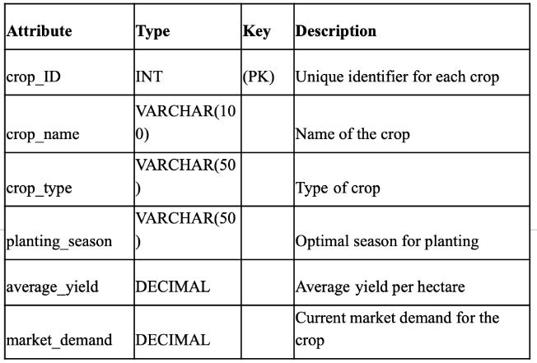
FARMER_DIM TABLE
CROP_DIM TABLE
Attribute | Type | Key | Description
farmer_ID | INT | (PK) | Unique identifier for each farmer
farmer_name | VARCHAR(100) |  | Name of the farmer
location_ID | INT | (FK) | Links to the Location dimension
farm_size | DECIMAL |  | Size of the farm (in acres)
contact_info | VARCHAR(255) |  | Contact information for the farmer
Crop Dimension: Stores crop details like type and season.
Farmer Dimension: Captures farmer information and farm size.

Slide 8
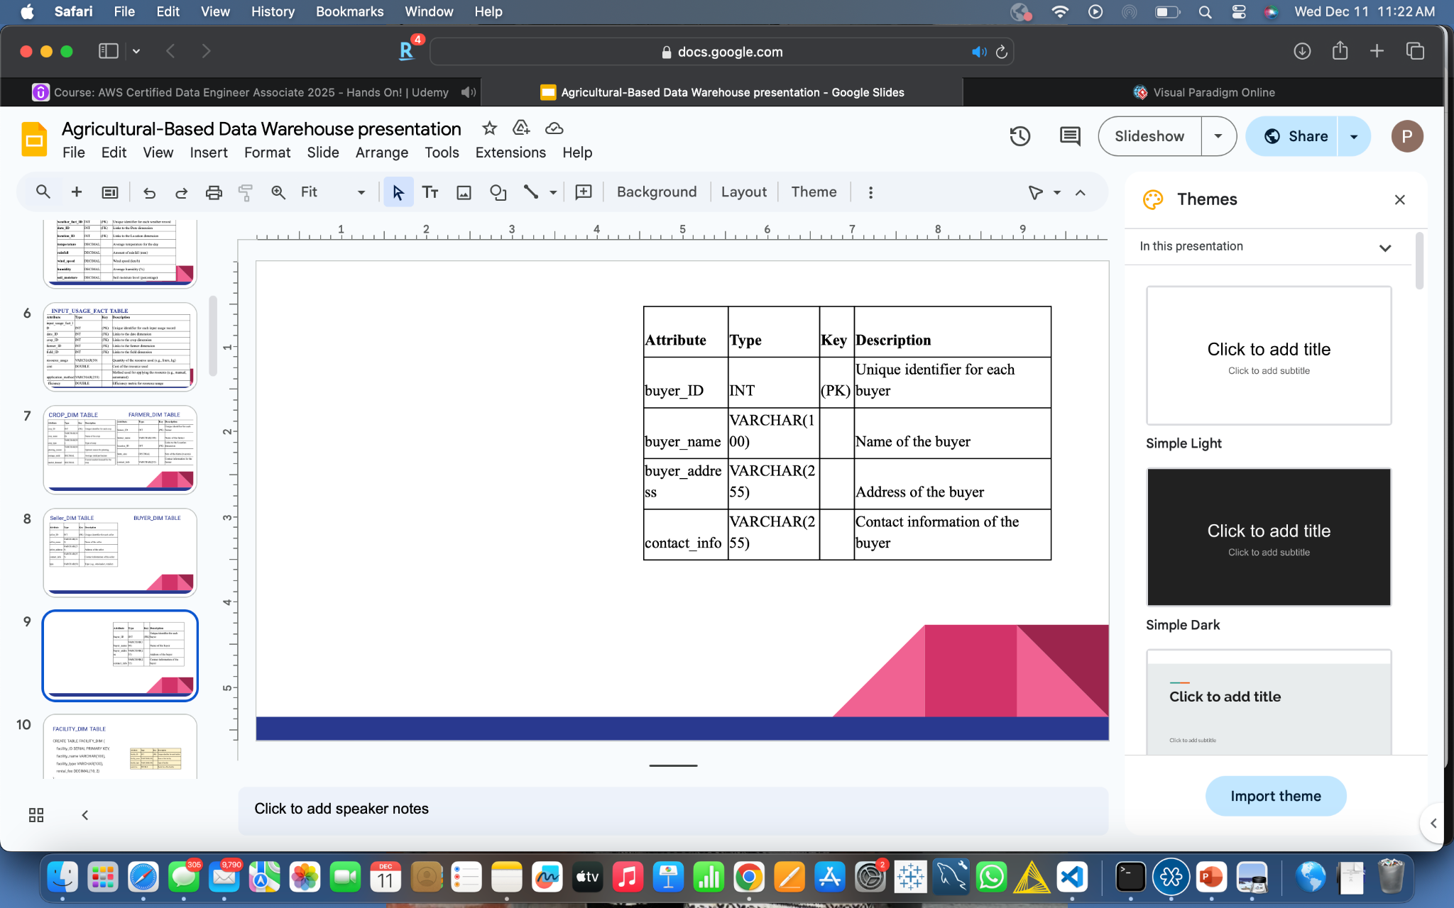
SELLER_DIM TABLE BUYER_DIM TABLE
Attribute | Type | Key | Description
seller_ID | INT | (PK) | Unique identifier for each seller
seller_name | VARCHAR(100) |  | Name of the seller
seller_address | VARCHAR(255) |  | Address of the seller
contact_info | VARCHAR(255) |  | Contact information of the seller
type | VARCHAR(50) |  | Type (e.g., wholesaler, retailer)
Seller Dimension: Details about sellers and their types.
Buyer Dimension: Records buyer information and locations.

Slide 9
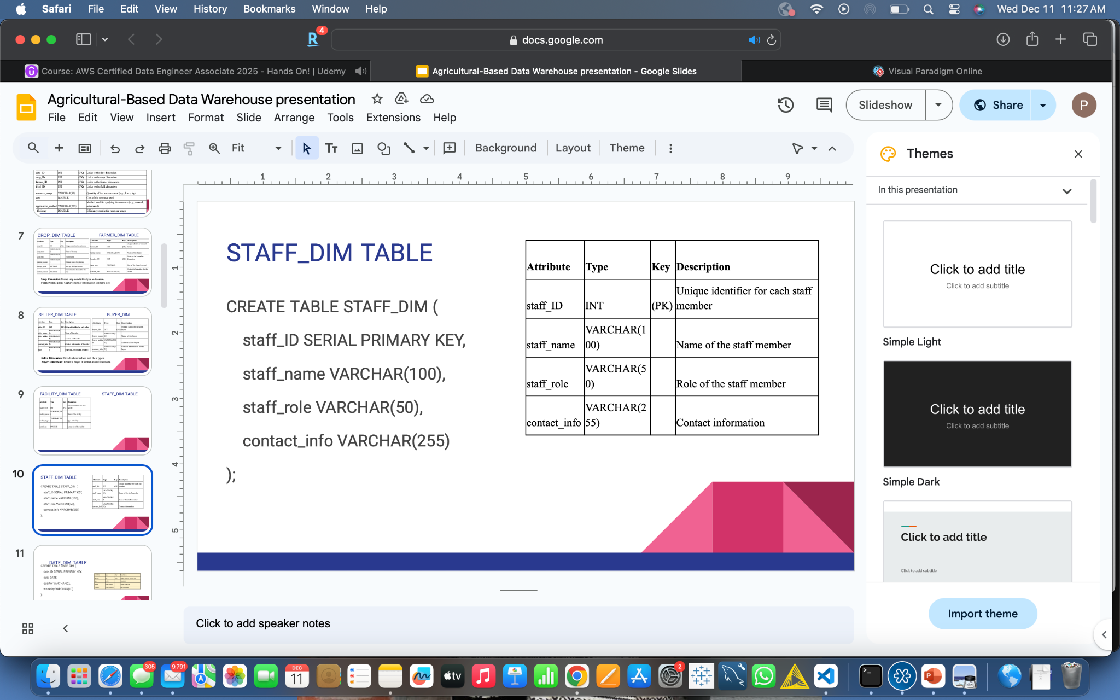
FACILITY_DIM TABLE STAFF_DIM TABLE
Attribute | Type | Key | Description
facility_ID | INT | (PK) | Unique identifier for each facility
facility_name | VARCHAR(100) |  | Name of the facility
facility_type | VARCHAR(100) |  | Type of facility
rental_fee | DOUBLE |  | Rental fee of the facility
Staff Dimension: Stores staff roles and contact information.
Facility Dimension: Details about storage and processing facilities.

Slide 10
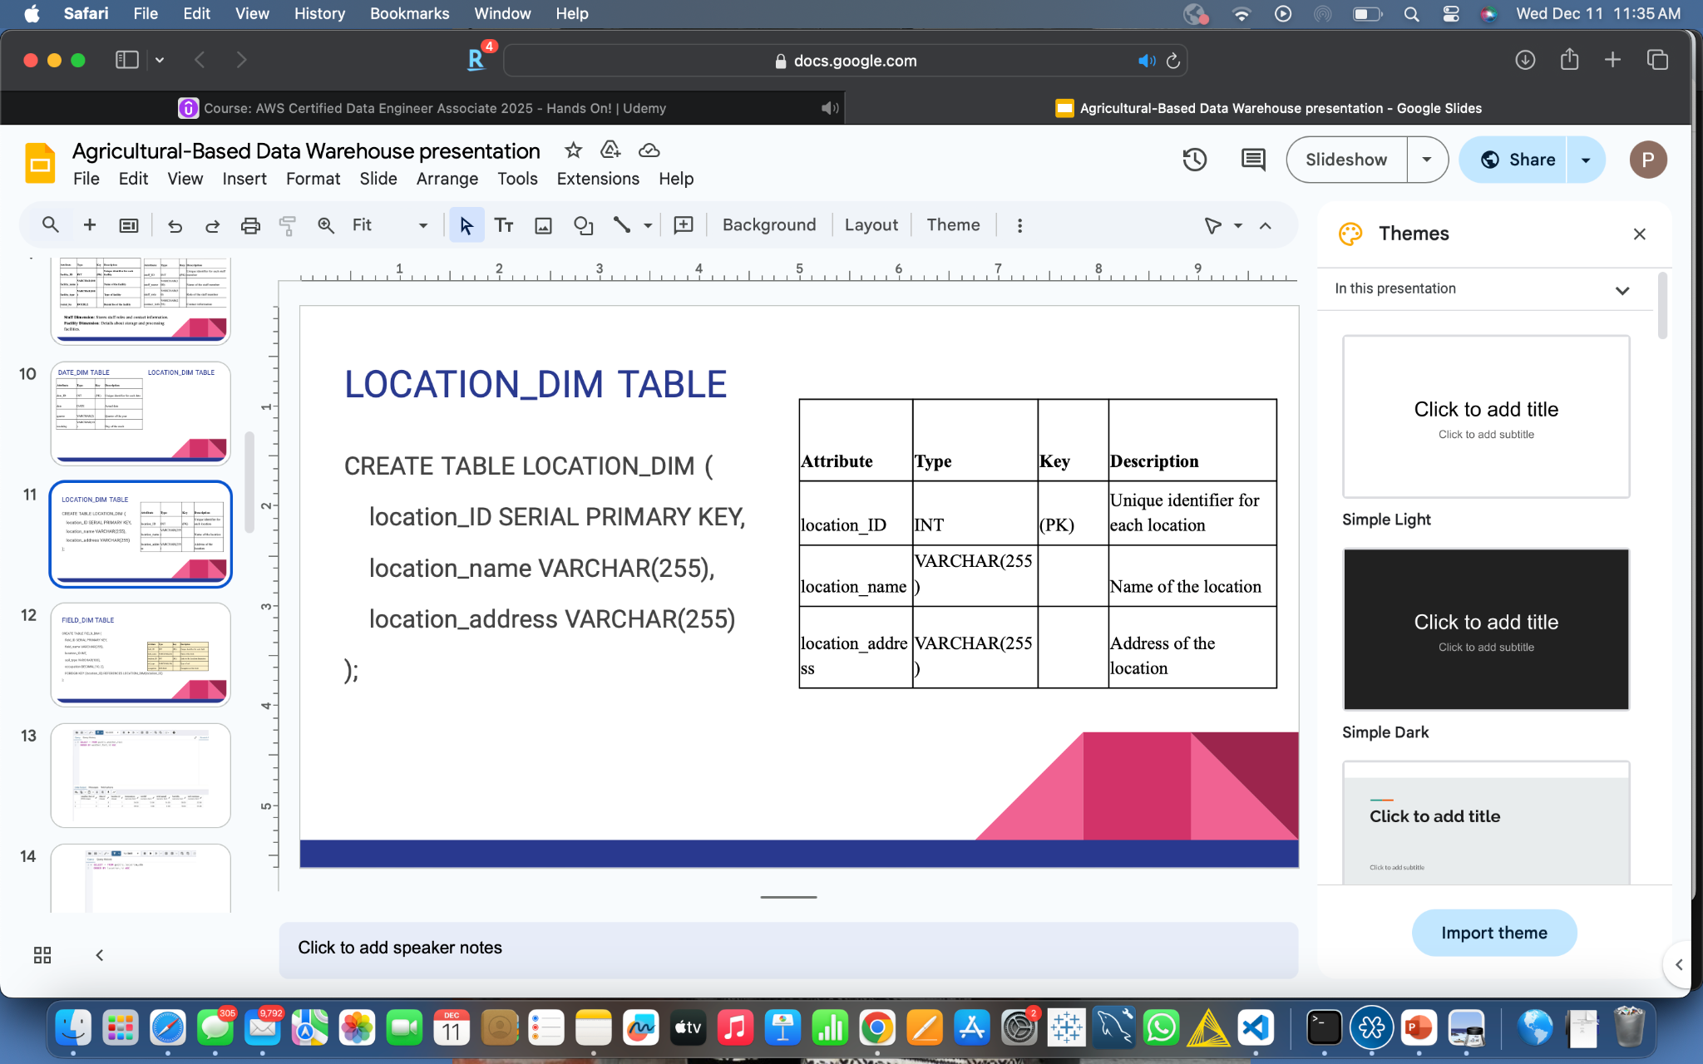
DATE_DIM TABLE LOCATION_DIM TABLE
Attribute | Type | Key | Description
date_ID | INT | (PK) | Unique identifier for each date
date | DATE |  | Actual date
quarter | VARCHAR(2) |  | Quarter of the year
weekday | VARCHAR(10) |  | Day of the week
Date Dimension: Tracks dates, quarters, and weekdays.
Location Dimension: Tracks farm or facility locations.

Slide 11
FIELD_DIM TABLE
Attribute | Type | Key | Description
field_ID | INT | (PK) | Unique identifier for each field
field_name | VARCHAR(255) |  | Name of the field
location_ID | INT | (FK) | Links to the Location dimension
soil_type | VARCHAR(100) |  | Type of soil
occupation | DOUBLE |  | Occupation of the field
By linking these tables, stakeholders can:
Uncover critical insights
Identify trends
Make data-driven decisions to optimize agricultural practices and resource management
Field Dimension: Provides details about fields and soil types.

Slide 12
Comparison of Traditional vs DW system
Aspect | Traditional Management | DW Applied Management
Data Integration | Fragmented data | Centralized storage
Data Retrieval | Time consuming and inconsistent results | Fast and consistent query performance
Scalability | Poor scalability with increased data volume | Scalable architecture for growing data
Analysis Capabilities | Limited and basic reporting | Advanced analytics
Data Accuracy | High risk of duplication | Improved accuracy with well-defined schema

Slide 13
ANALYSIS
What Analysis Are We Doing?
We have grouped a set of SQL queries designed for:
Revenue analysis: Analyze total sales, revenue per crop, and buyer-seller performance using metrics like total revenue, sales distribution, and contribution to overall profits.
Production trends: Uncover seasonal patterns and optimize planting and harvesting schedules.
Resource efficiency: Measure efficiency metrics like average resource usage, cost per unit of yield, and resource application methods across crops or farmers.
Weather impact on crops: To understand how weather conditions affect crop yield and market pricing.
Crop Yield Analysis: Evaluate crop yield performance across farmers, locations, and seasons using different metrics.

Slide 14
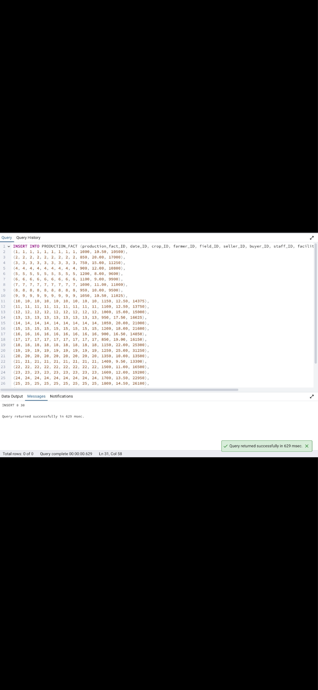
DATA INSERTION

Slide 15
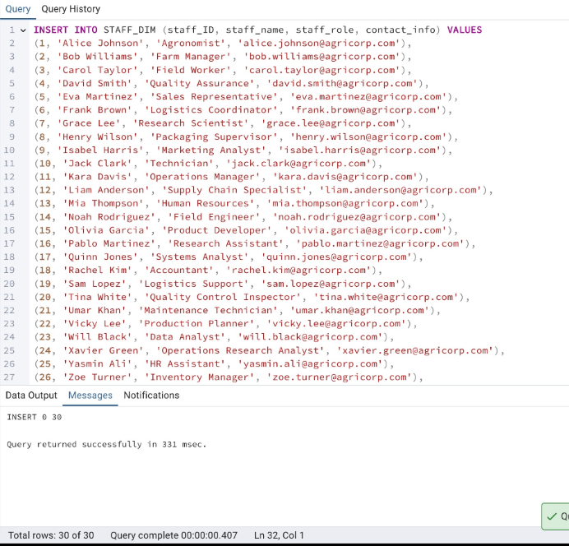
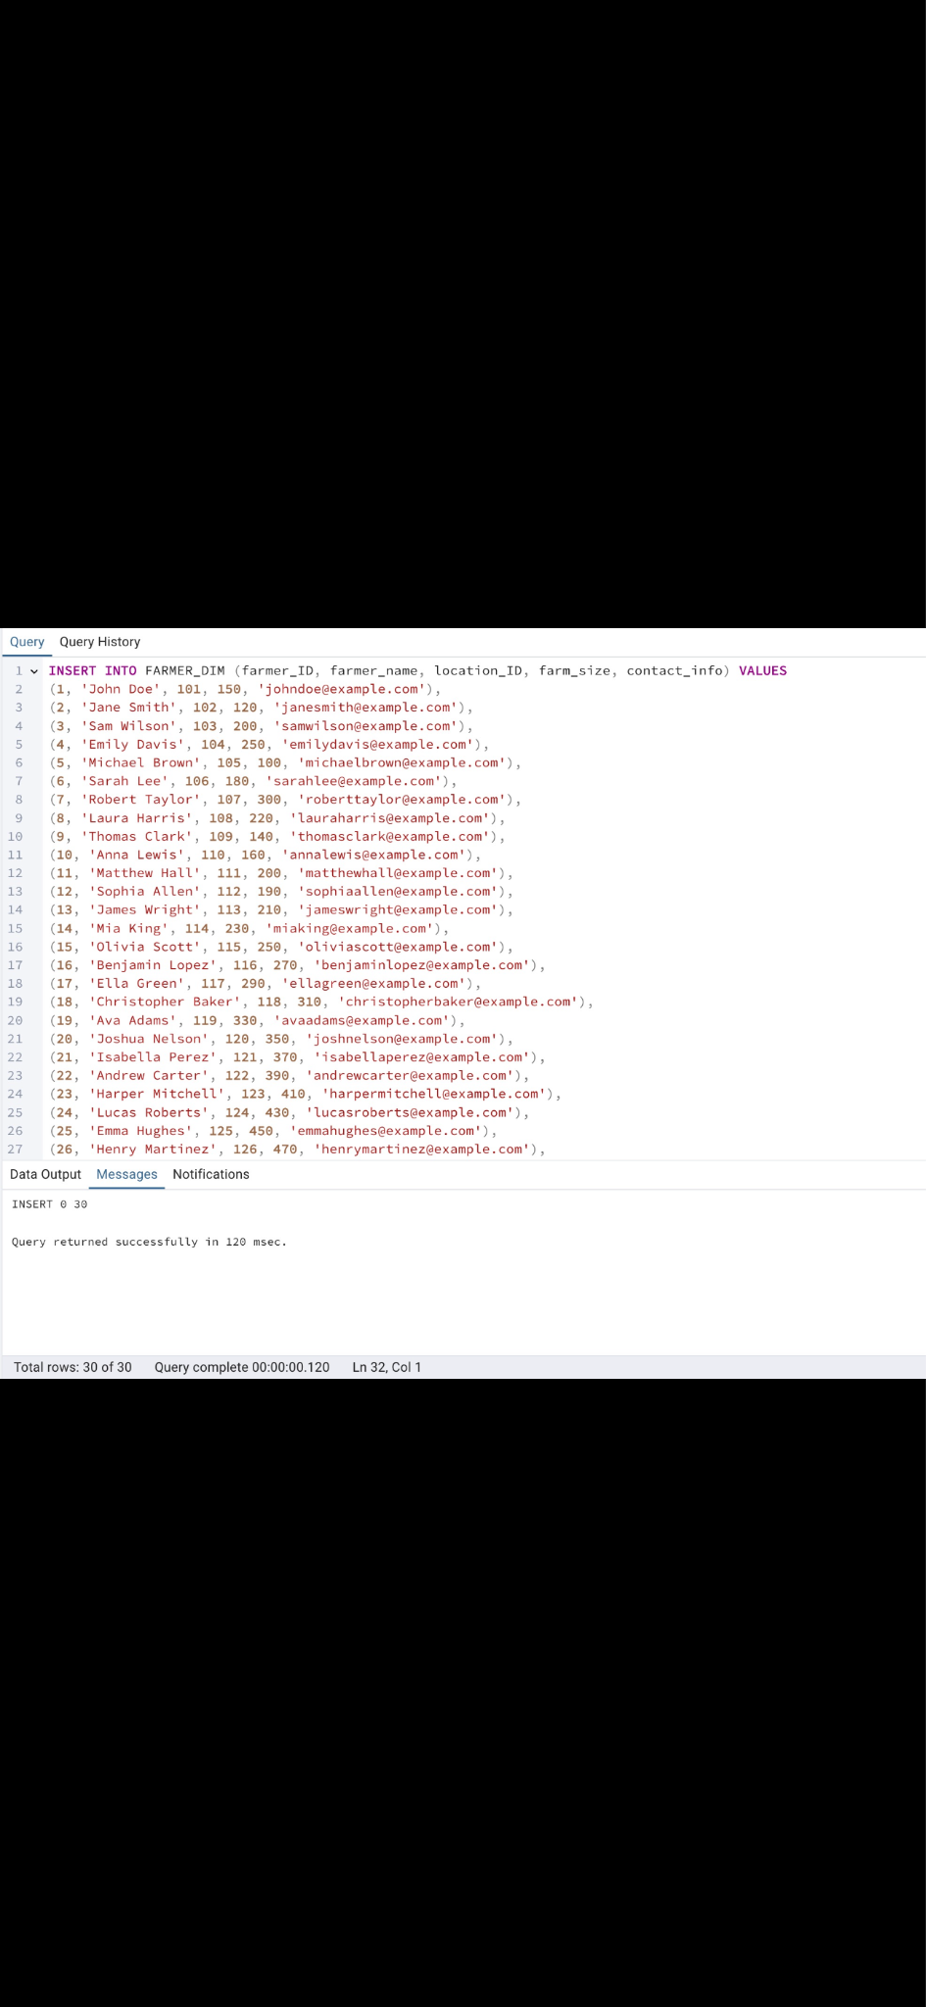

Slide 16
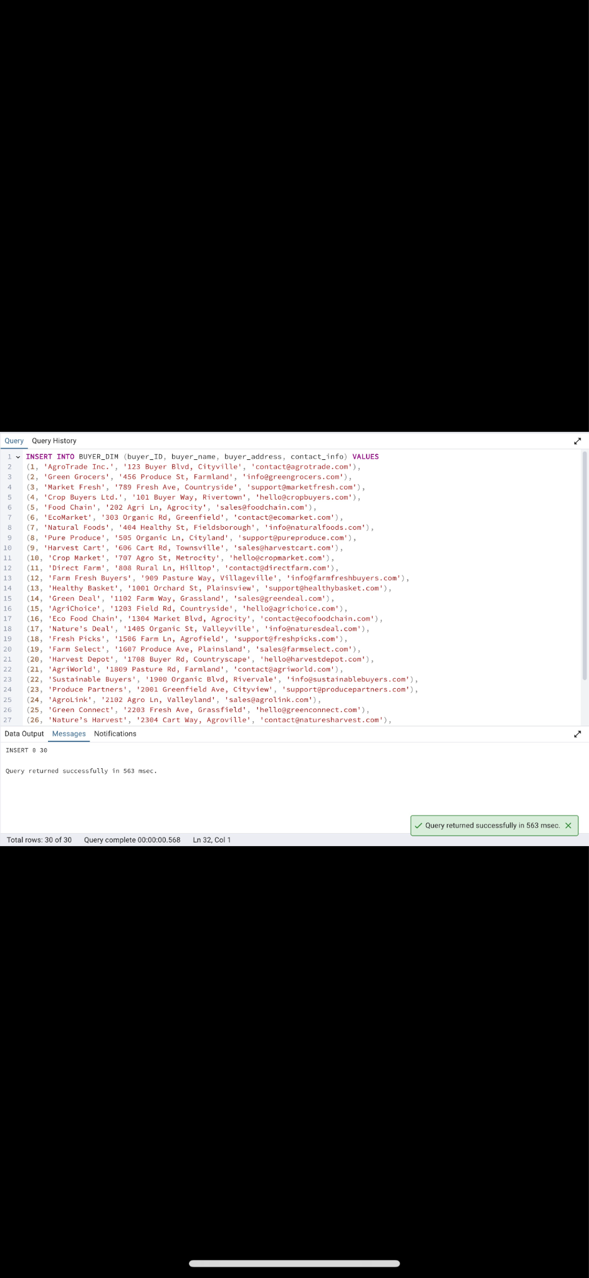

Slide 17
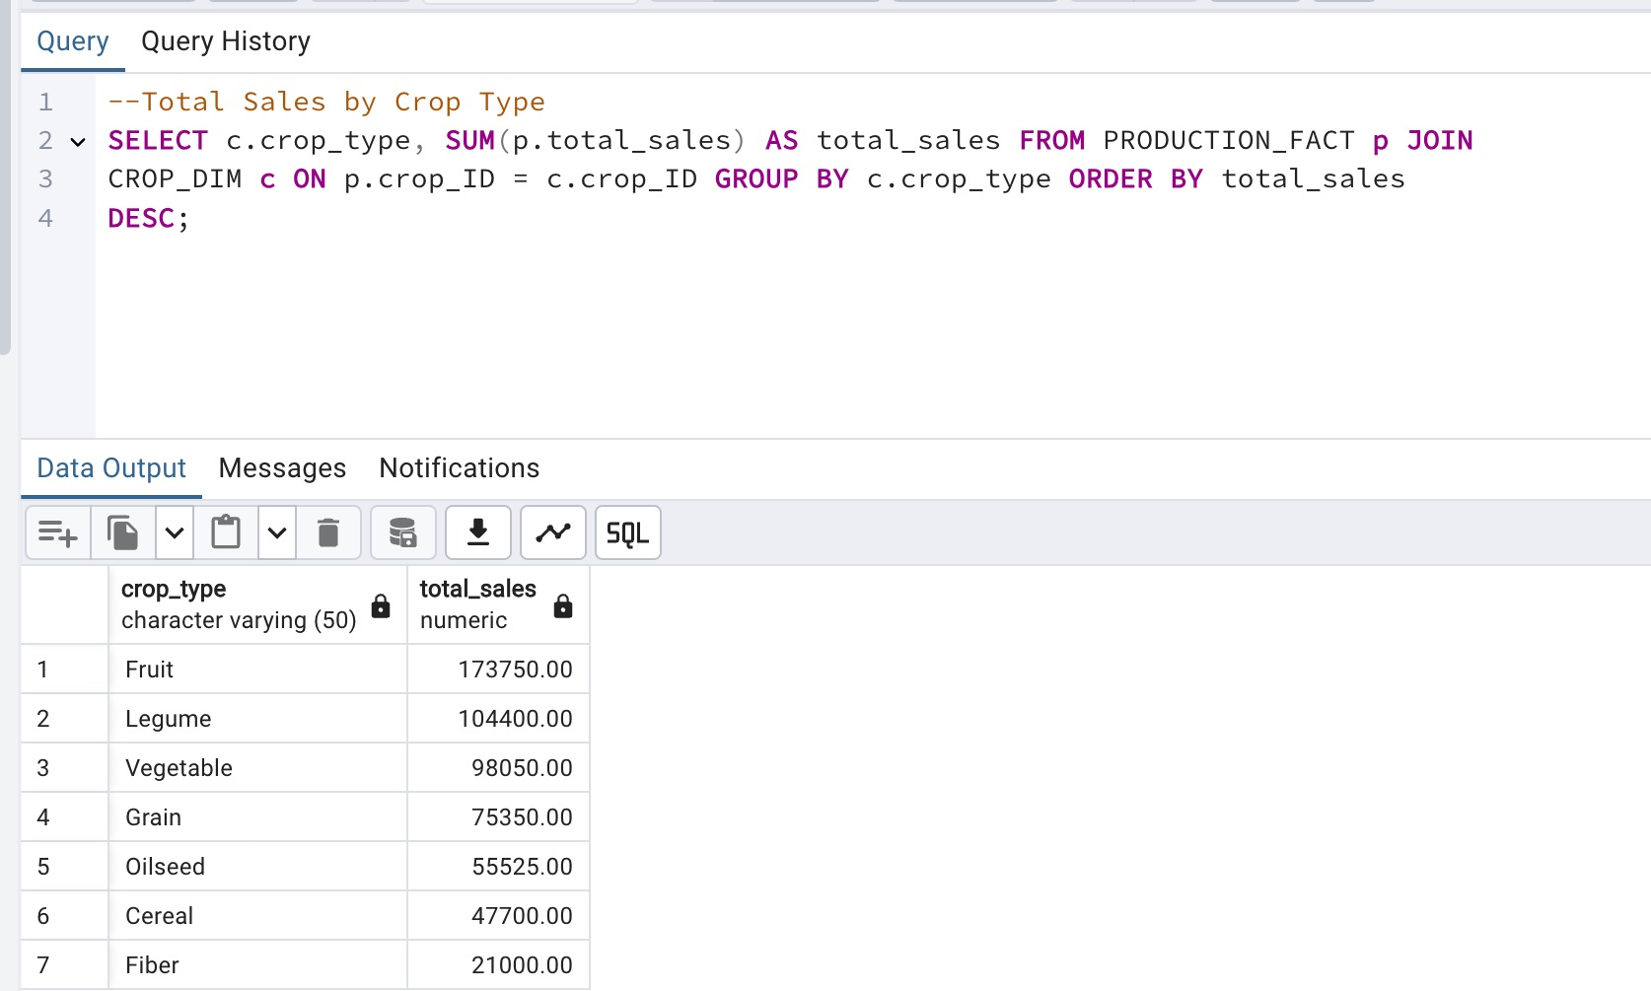
QUERIES: Revenue Analysis #1:Total sale by crop type

Slide 18
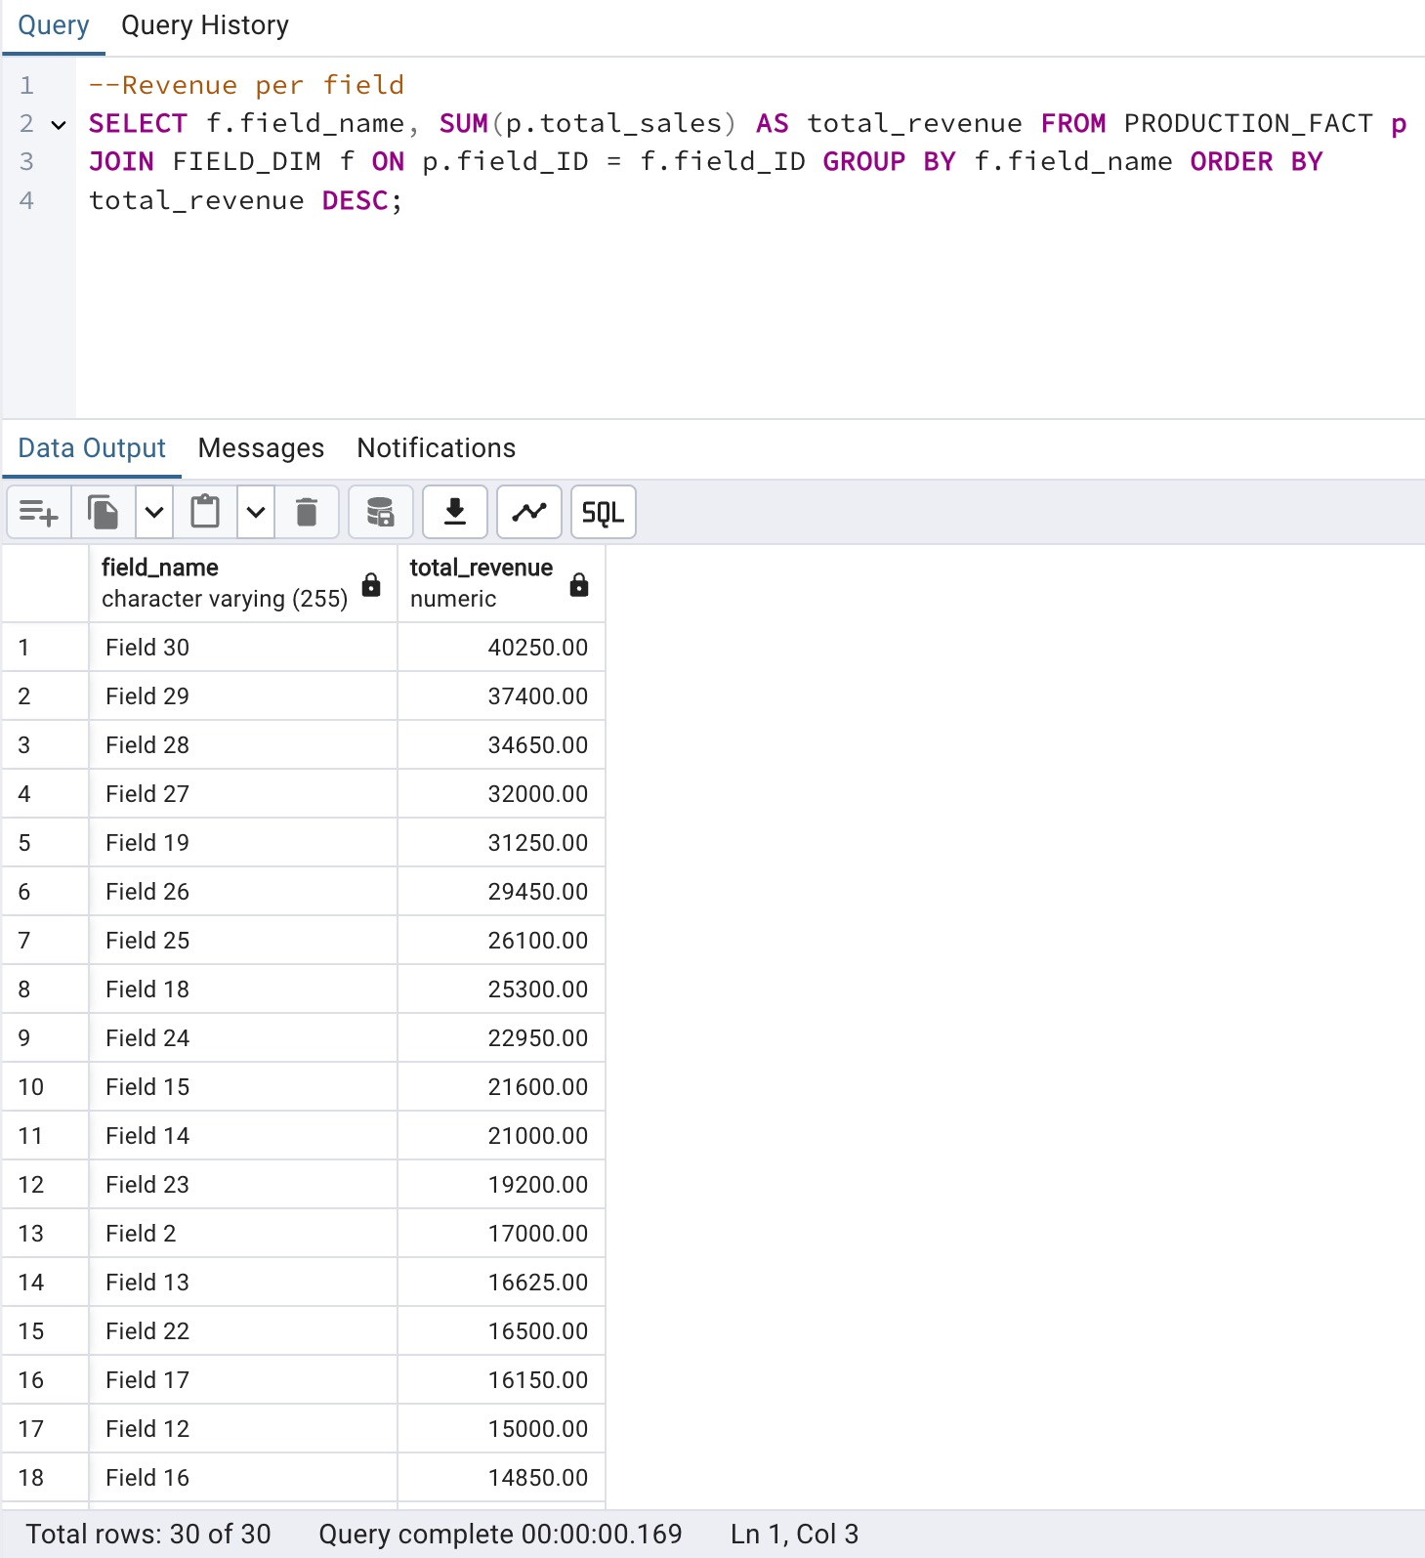
#2 Revenue per Field

Slide 19
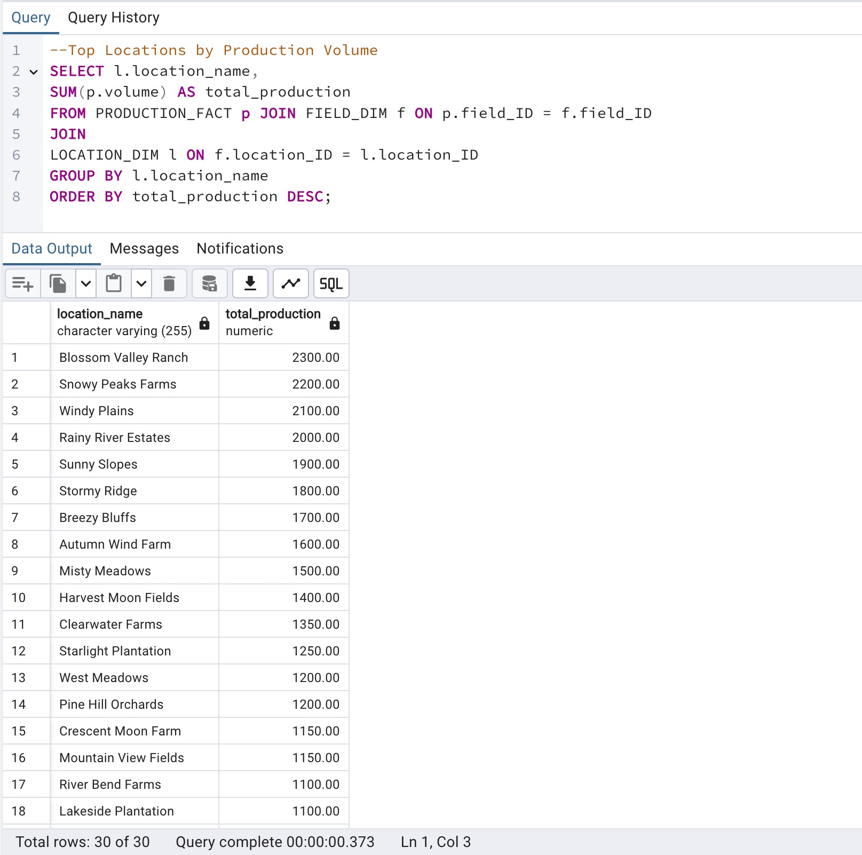
#1 Top locations by production volumes
PRODUCTION TREND ANALYSIS

Slide 20
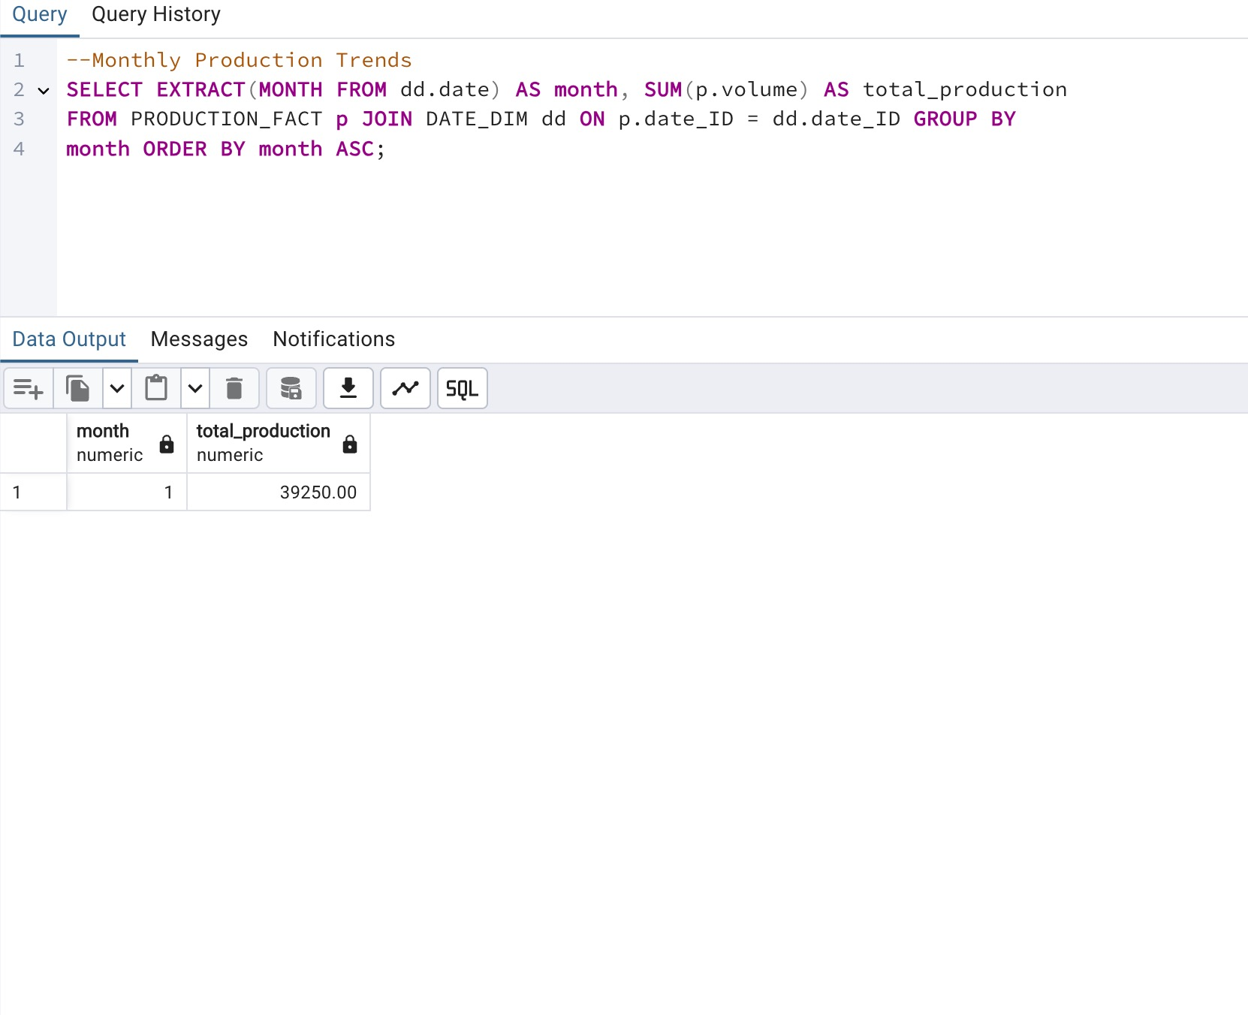
#2 Monthly production trends

Slide 21
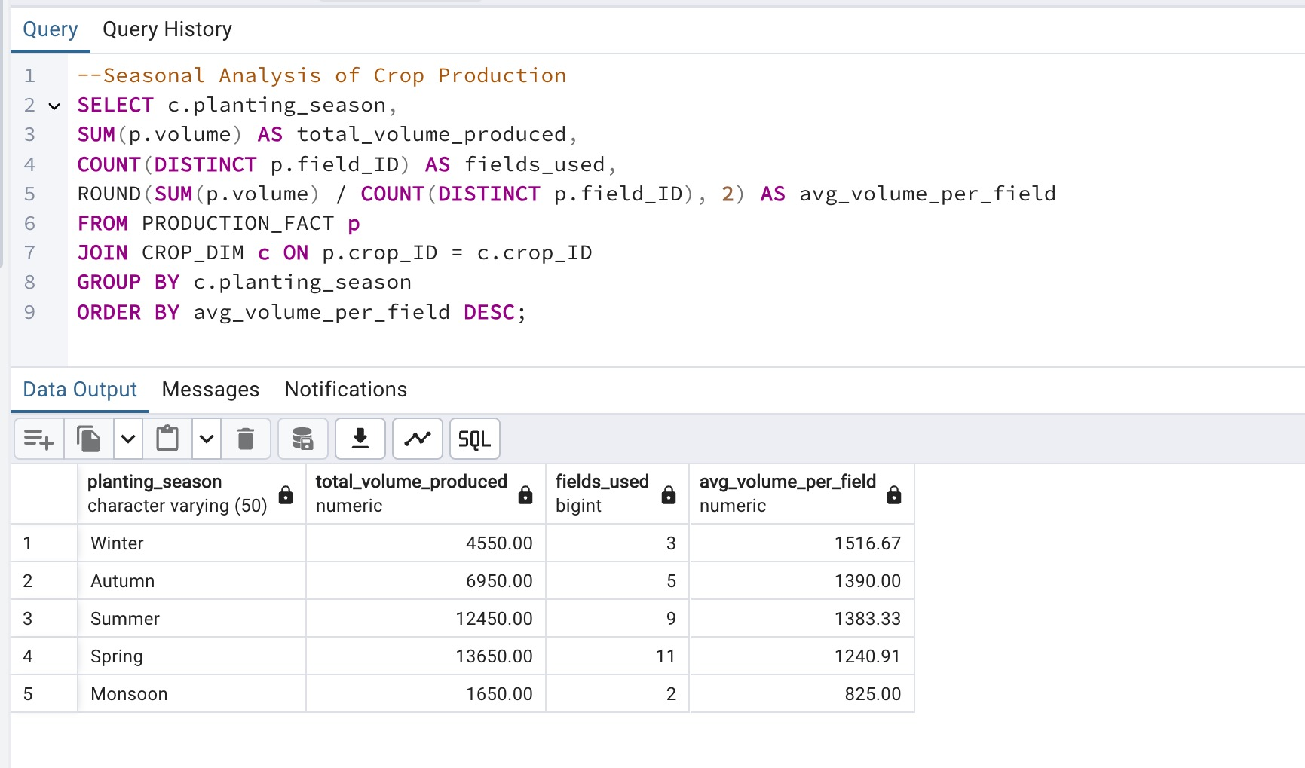
#3 Seasonal Analysis of Crop Production

Slide 22
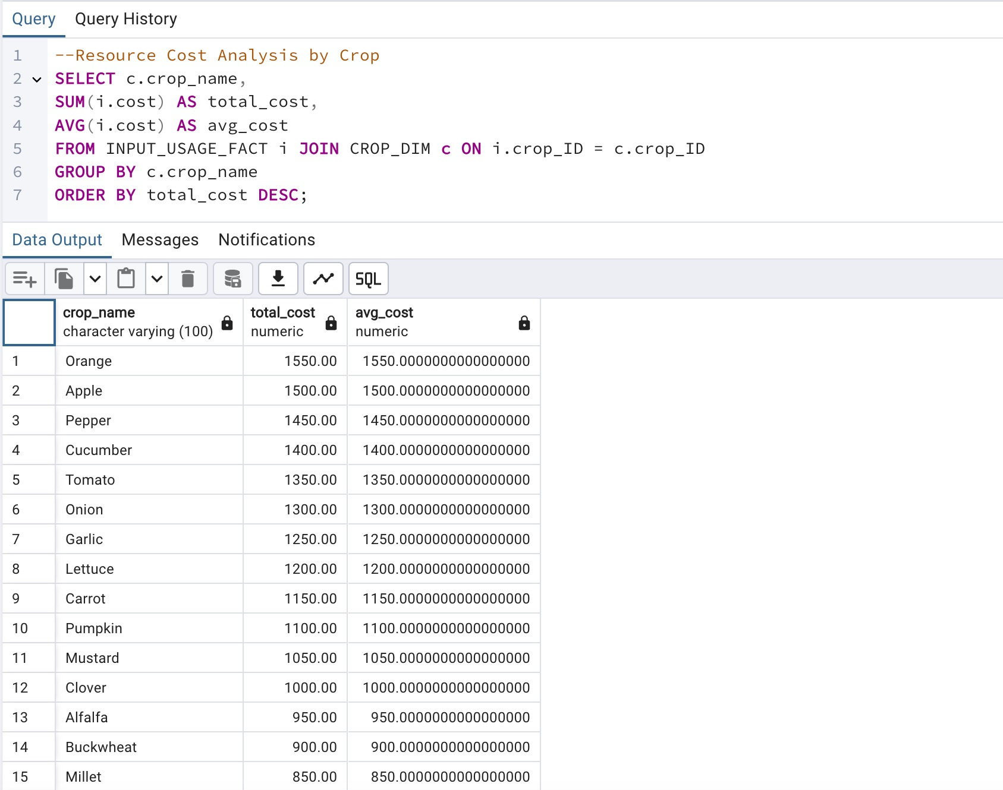
RESOURCE EFFICIENCY ANALYSIS
#1 Resource Cost Analysis by crop

Slide 23
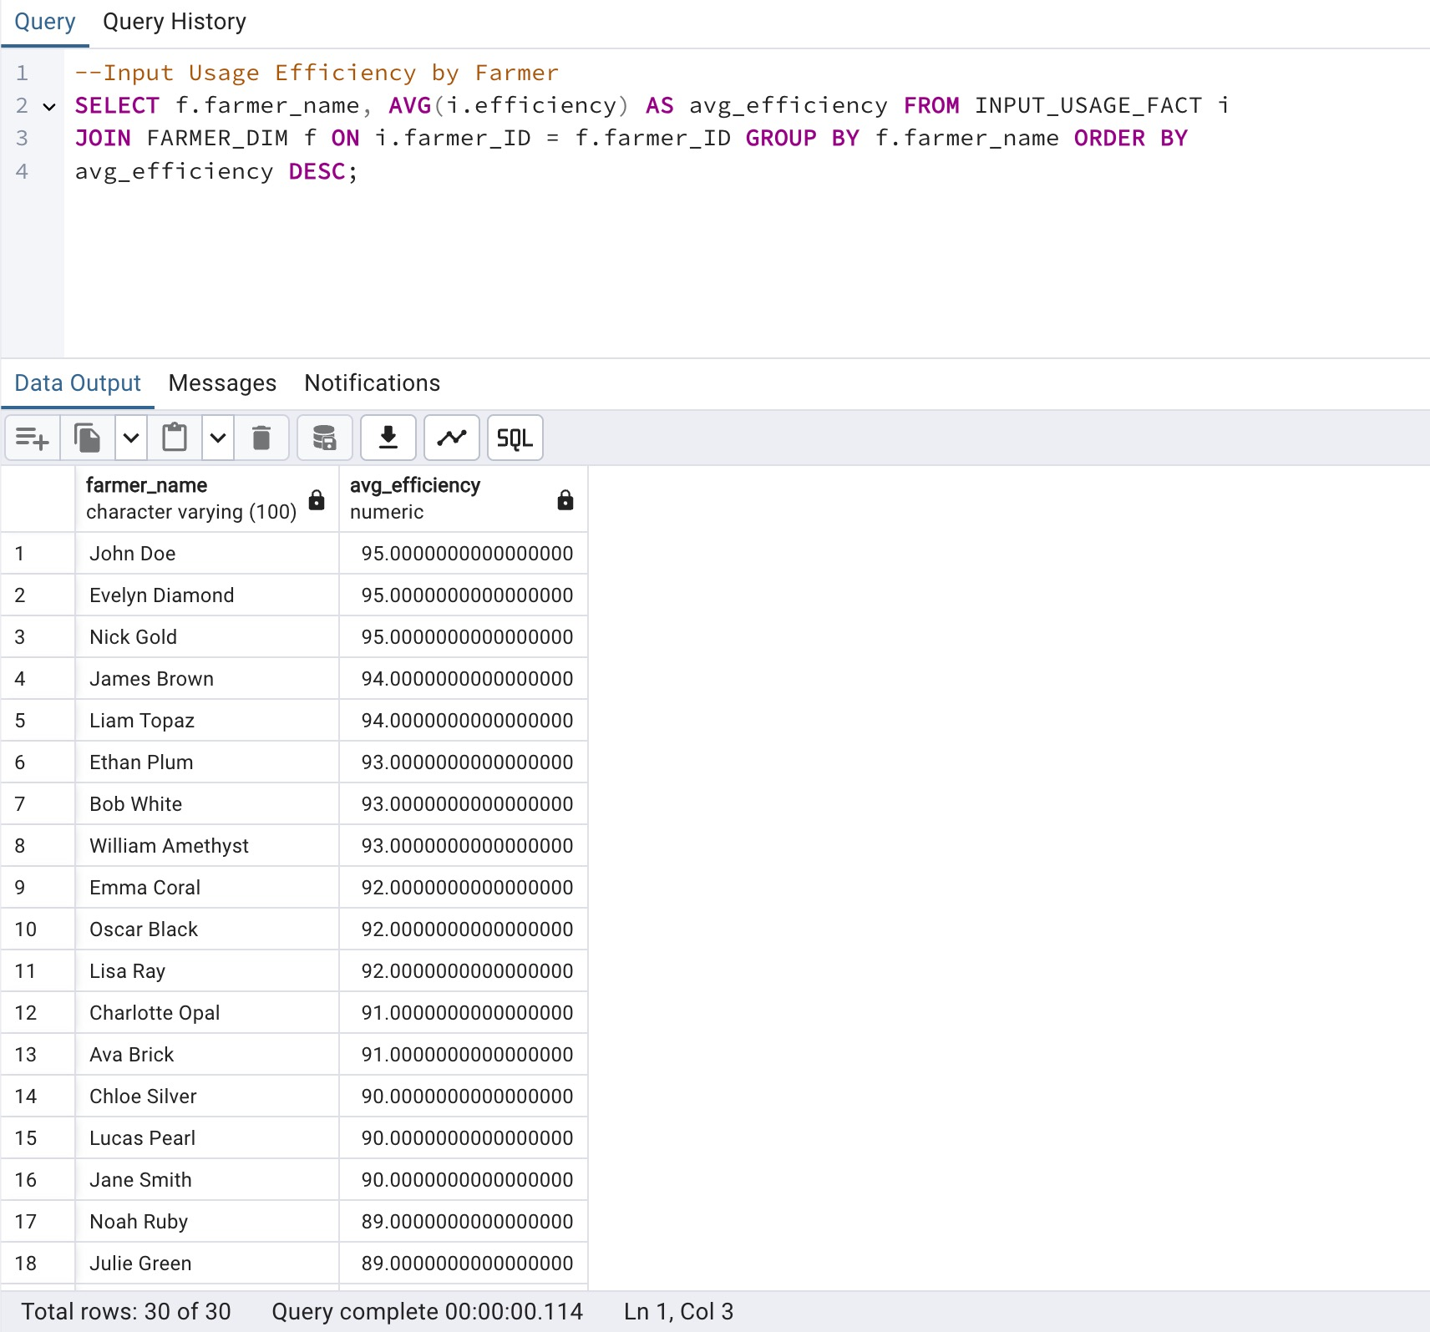
#2 Input usage efficiency by farmer

Slide 24
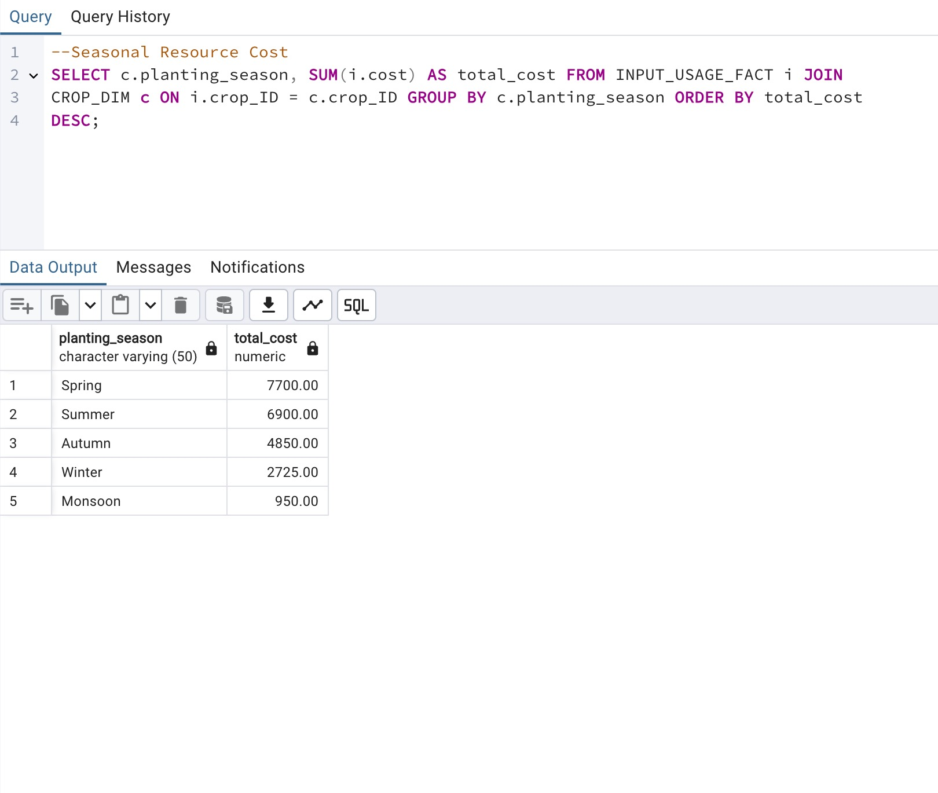
#3 Seasonal Resource Cost

Slide 25
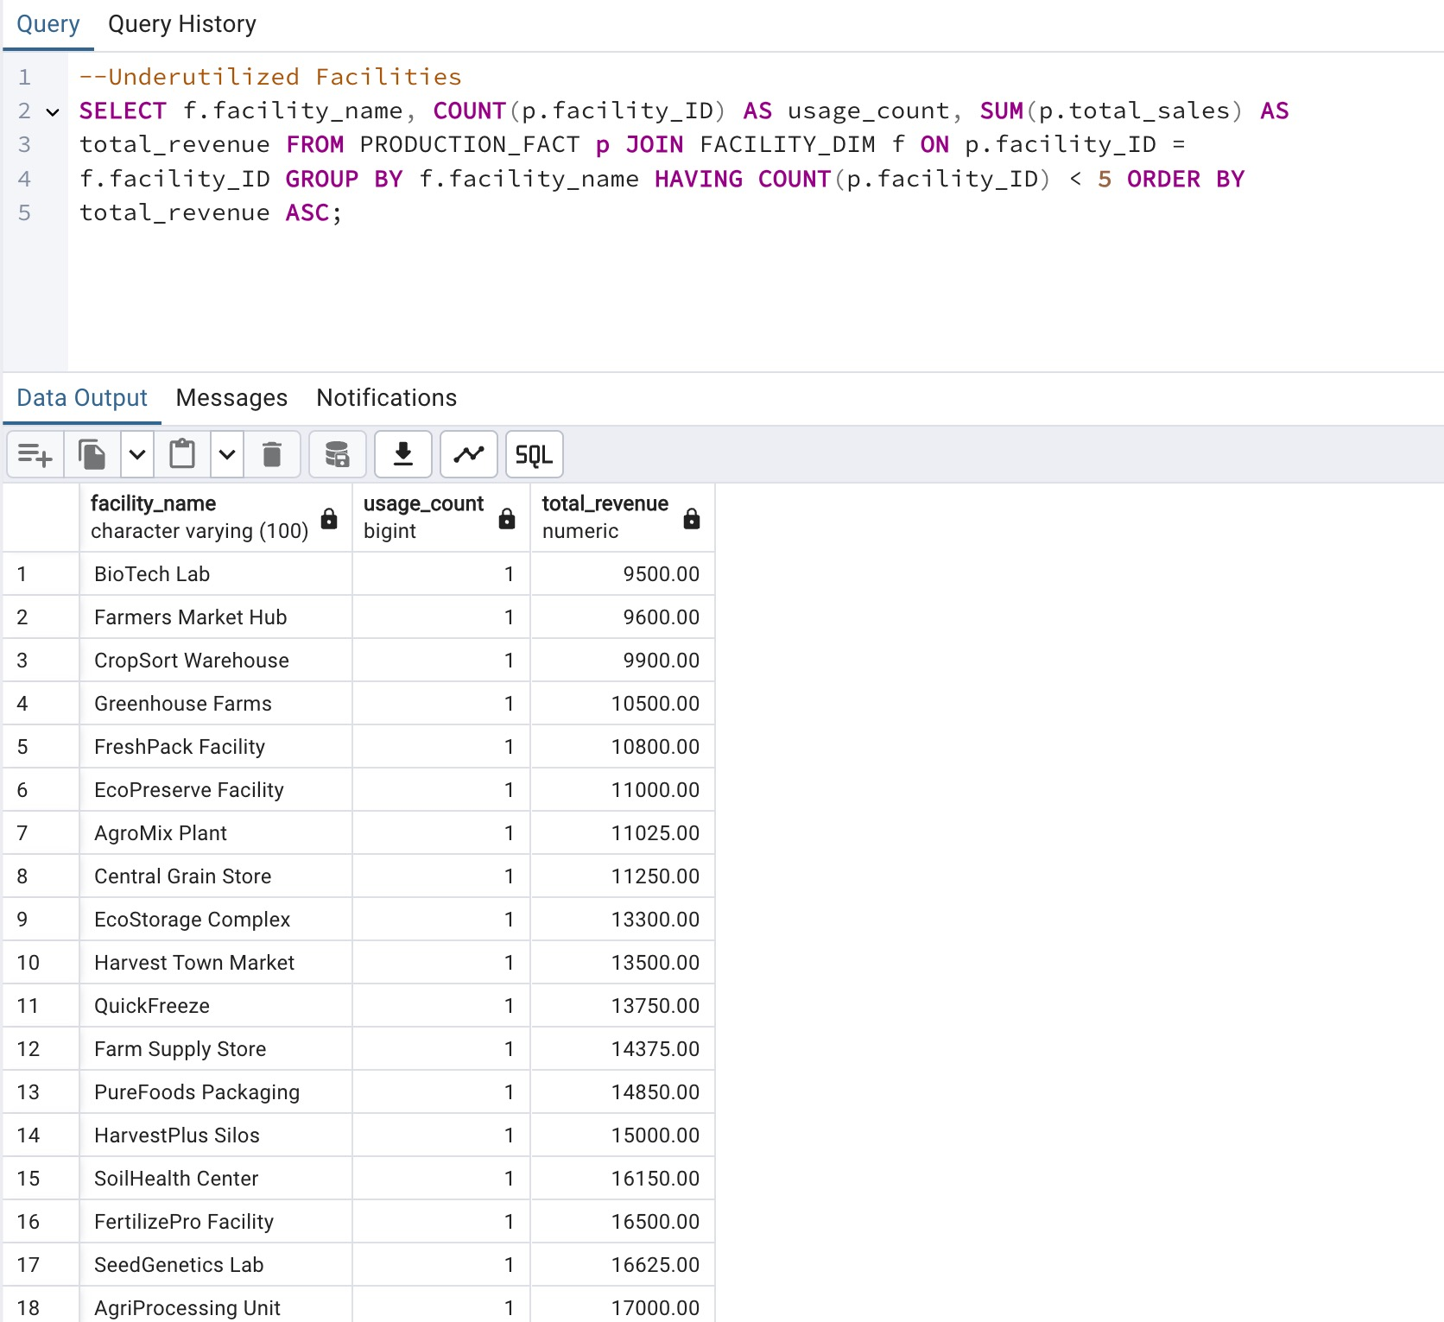
#4 Underutilized Facilities

Slide 26
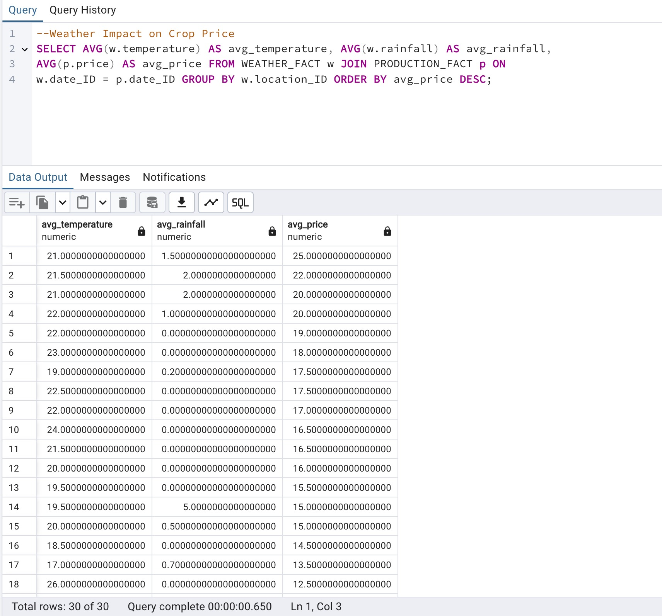
WEATHER IMPACT ON CROP ANALYSIS
#1 Weather impact on Crop Price

Slide 27
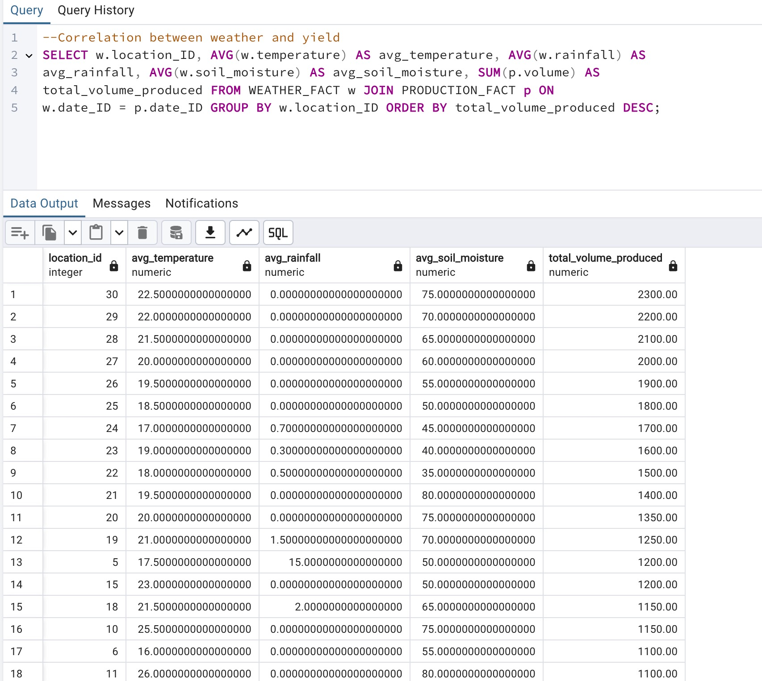
#2 Correlation between weather and yield

Slide 28
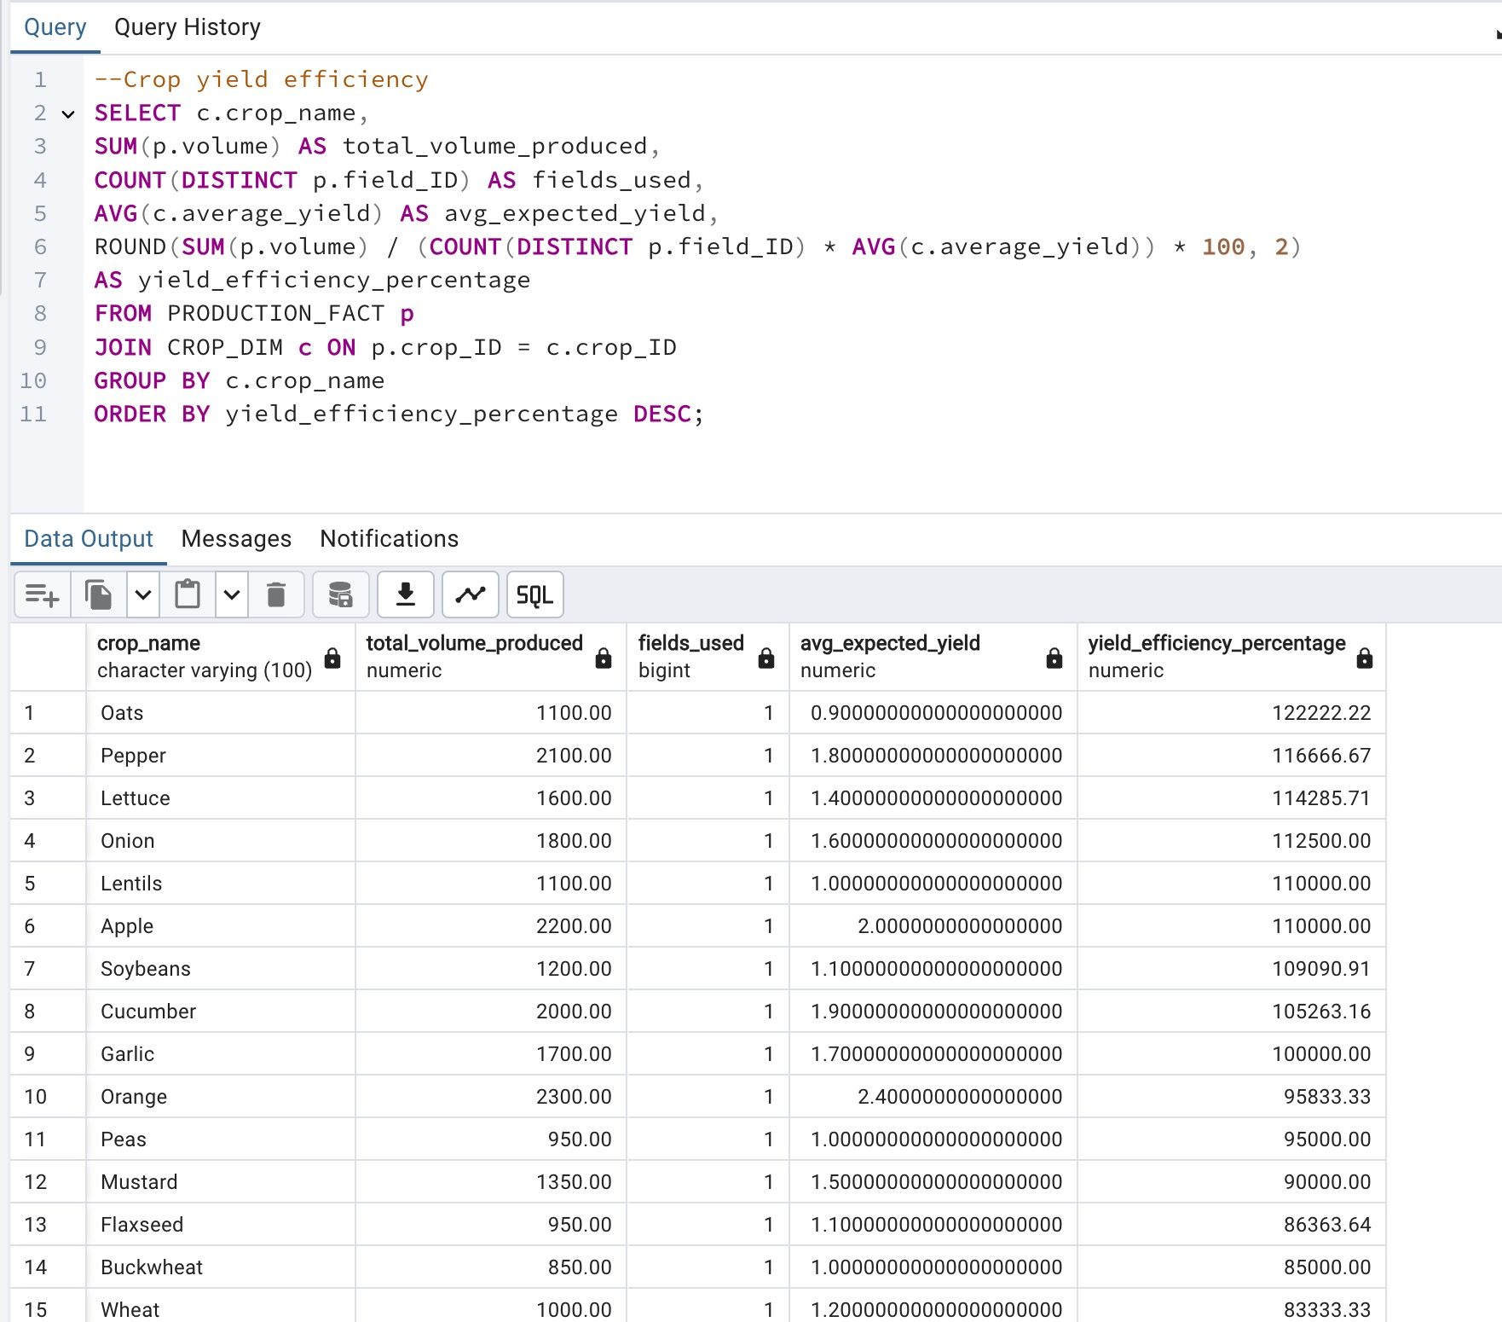
CROP YIELD EFFICIENCY ANALYSIS
#1Crop Yield Efficiency

Slide 29
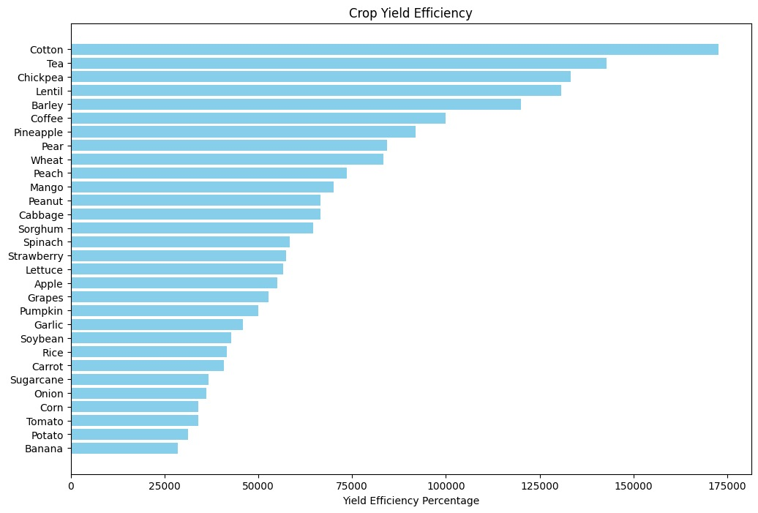
Crop yield efficiency
Graph

Slide 30
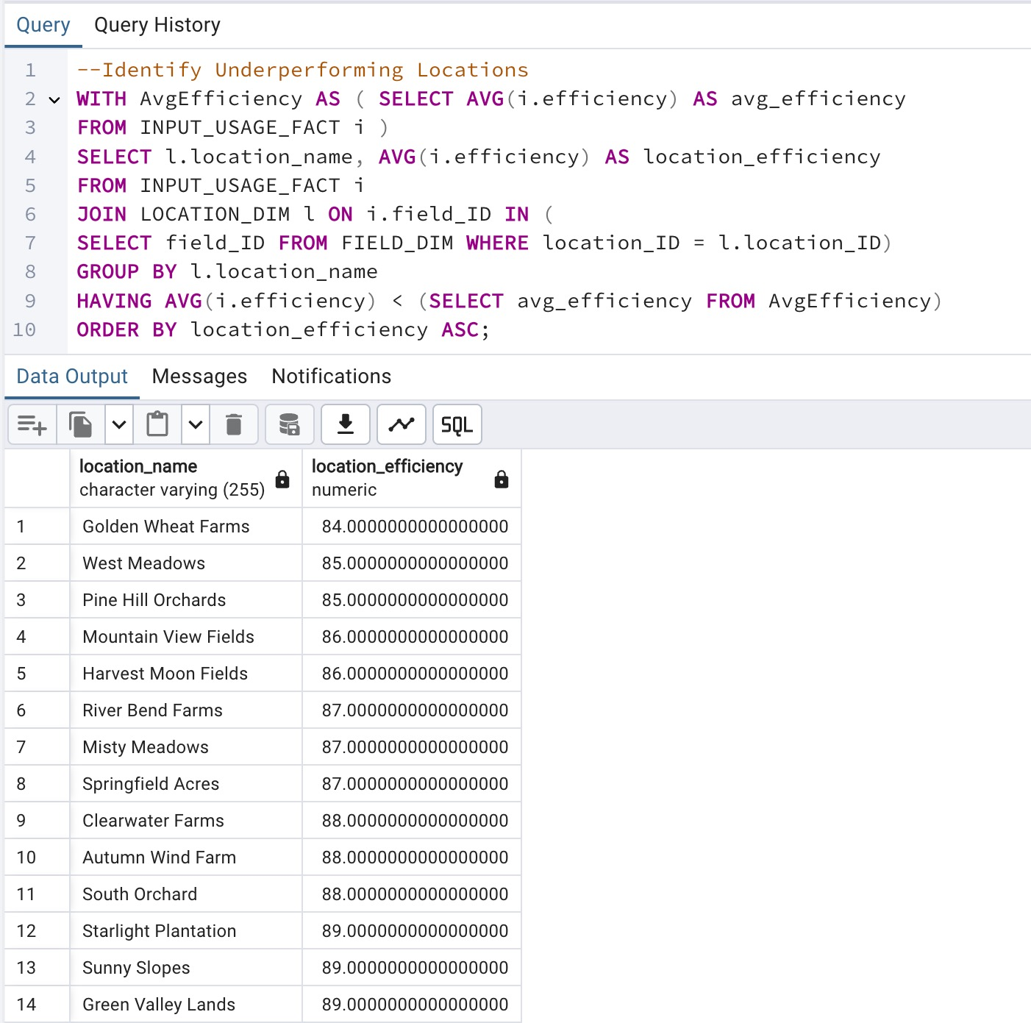
#2 Underperforming Locations

Slide 31
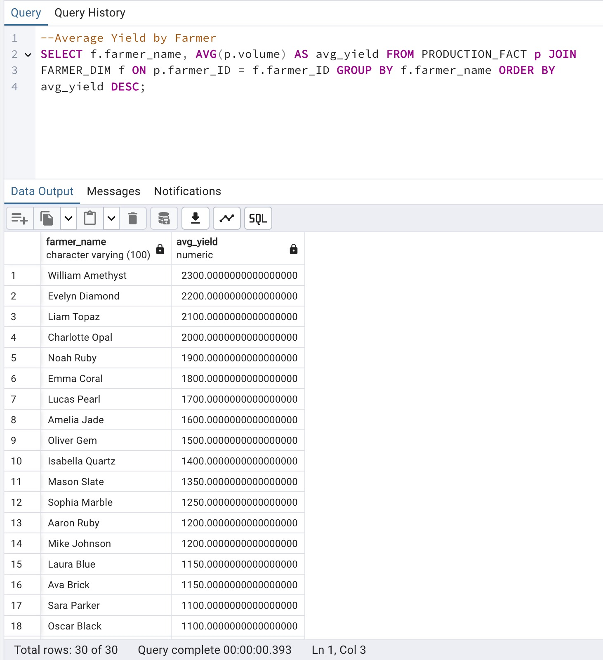
#3 Average Yield by Farmer

Slide 32
CONCLUSION
To conclude, the analysis provides critical insights into various aspects of agricultural performance, including revenue drivers, production trends, resource efficiency, weather impacts, and crop yield.
These are all important computations which demonstrates efficiency of our DW model.
Hence, the entire integration will have the ability for better planning, and adaptability to changing conditions, ultimately enhancing productivity and efficiency in the agricultural ecosystem.

Slide 33
REFERENCES
Singh, A., & Singh, R. (2019). Application of Data Warehousing and Data Mining in Agriculture. International Journal of Computer Applications. This paper provides an overview of how data warehousing and mining can be applied to the agriculture sector to help improve farm productivity and decision-making.
Kaushik, G., & Saini, J. R. (2017). Data Mining Techniques for Agriculture Data Using Decision Tree Algorithms. International Journal of Advanced Research in Computer and Communication Engineering. This article discusses various data mining techniques and how they can be applied to agriculture data to assist in predictive modeling and decision-making.
Data Mining Techniques for Agriculture Data Using Decision Tree Algorithms, Kaushik, G., & Saini, J. R. (2017). Discusses various data mining techniques, particularly decision trees, and their application to agriculture data to assist in predictive modeling and decision-making.
FAO (Food and Agriculture Organization of the United Nations) (2020). Big Data and Artificial Intelligence for Agriculture Innovation. This report provides insights into how big data technologies, including data warehousing, are transforming agricultural practices and supporting sustainable farming.
Design and development of a data warehouse framework for Highland Vegetable Crops in Benguet. Quitaleg, A. R., & Ortiz, M. G. (2020). This study details the development of a data warehouse framework designed to manage data for highland vegetable crops, focusing on enhancing decision-making and operational efficiency.
Ngo, V. M., Le-Khac, N.-A., & Kechadi, M.-T. (2019). Designing and implementing data warehouse for Agricultural Big Data. Lecture Notes in Computer Science, 1–17. https://doi.org/10.1007/978-3-030-23551-2_1
Othmane Friha, Mohamed Amine Ferrag, Lei Shu, Leandros Maglaras, and Xiaochan Wang, "Internet of Things for the Future of Smart Agriculture: A Comprehensive Survey of Emerging Technologies," IEEE/CAA J. Autom. Sinica, vol. 8, no. 4, pp. 718-752, Apr. 2021. doi: 10.1109/JAS.2021.1003925

Slide 34
THANK YOU

